Slide 1

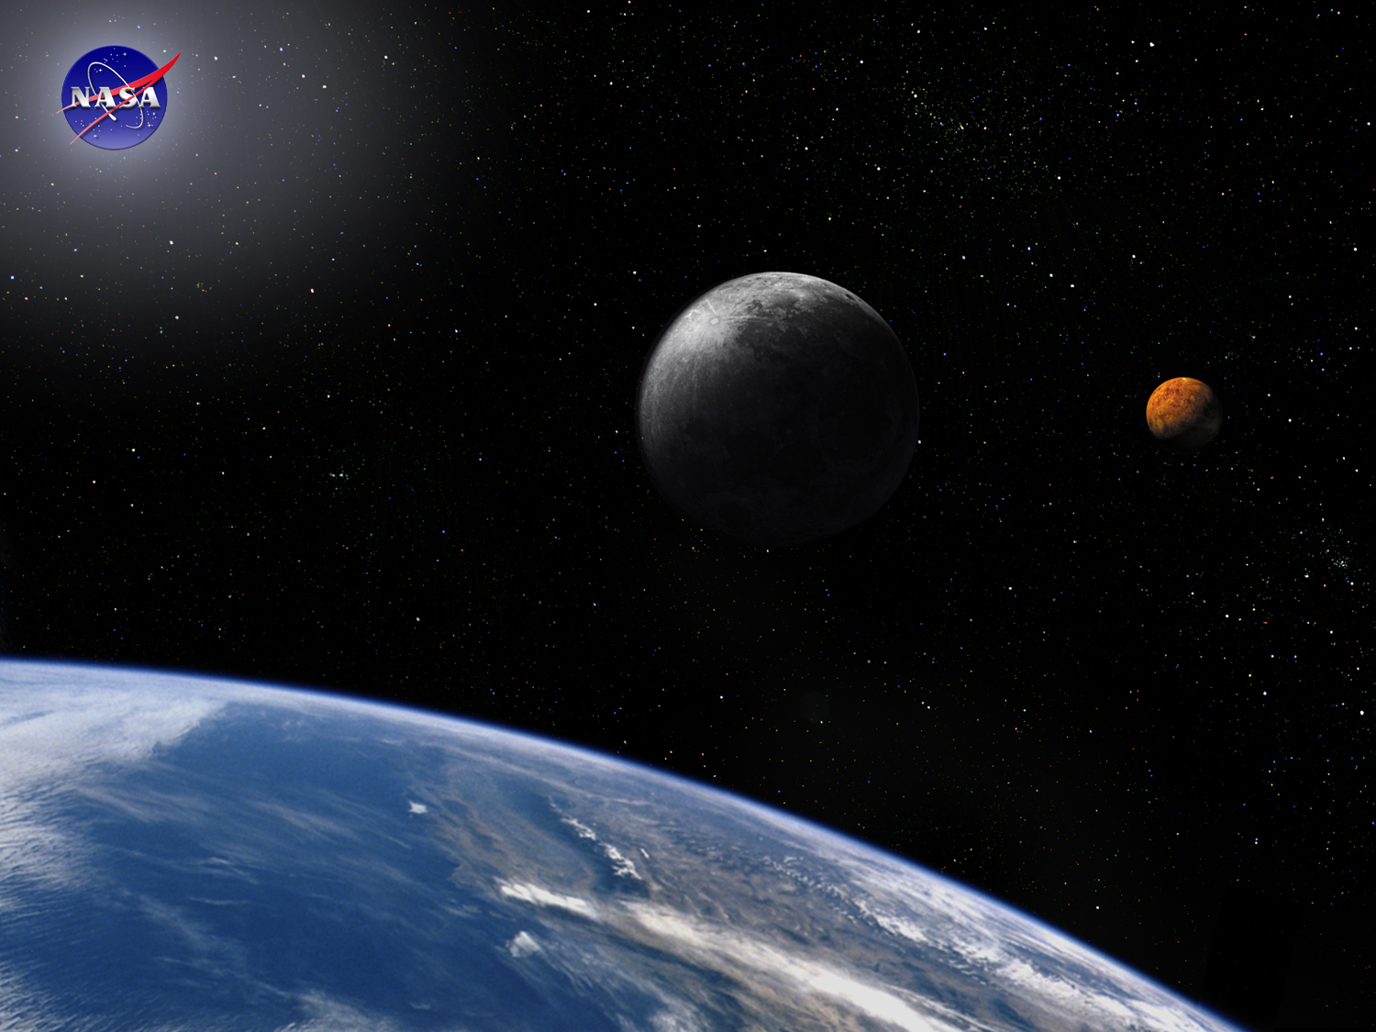

Introduction Module:
What is Systems Engineering?
Space Systems Engineering, version 1.0
Notes:
Version 1.0
SOURCE INFORMATION:
The material contained in this lecture was developed by Lisa Guerra of NASA’s Exploration Systems Mission Directorate while on assignment in the Department of Aerospace Engineering at the University of Texas at Austin. As part of a course entitled, Space Systems Engineering, the lecture was piloted at UT-Austin in Spring 2008.
The content that follows was also reviewed and edited by Dr. Paul Graf, Adjunct Professor at the University of Colorado at Boulder.

Slide 2
Module Purpose: What is Systems Engineering?
Provide some common definitions of systems engineering in the context of space project development.
Motivate the need for systems engineering and demonstrate the consequences of poor systems engineering.
Describe how systems engineering adds value to the development of large projects.
Develop some common systems engineering process models and show how they are related.

Slide 3
What is Systems Engineering?
Systems engineering is a robust approach to the design, creation, and operation of systems.
The approach consists of:
  identification and quantification of system goals
  creation of alternative system design concepts
  performance of design trades
  selection and implementation of the best design
  verification that the design is properly built and integrated, and
  assessment of how well the system meets the goals
This approach is iterative, with several increases in the resolution of the system baselines (which contain requirements, design details, verification plans and cost and performance estimates).
Ares 1
Notes:
Source: NASA Systems Engineering Handbook SP-6105 (1995)

Slide 4



Original Reasons for Systems Engineering
Vasa, Sweden, 1628
Systems of pieces built by different
subsystem groups did not perform
system functions
  Often broke at the interfaces
Problems emerged and desired properties did not
when subsystems designed independently were integrated
Managers and chief engineers tended to pay
attention to the areas in which they were skilled
Developed systems were not usable
Cost overruns, schedule delays,
performance problems
Photo from Dec 1999 Civil Engineering magazine
$
Notes:
Source: Twelve Roles and Three Types of Systems Engineering
Sarah A. Sheard; Software Productivity Consortium; February 11, 2003; GSFC Systems Engineering Seminar Series

Slide 5
More Motivation for Systems Engineering
There is tremendous potential for wasted effort on large projects, since their development requires that many subsystems be developed in parallel.
Without a clear understanding of what must be done for each subsystem the development team runs the risk of inconsistent designs, conflicting interfaces or duplication of effort.
Systems engineering provides a systematic, disciplined approach to defining, for each member of the development team, what must be done for success.
Notes:
Using Historical NASA Cost and Schedule Growth to Set Future Program and Project Reserve Guidelines; Debra L. Emmons, Robert E. Bitten, Claude W. Freaner; IEEE Aerospace Conference, Big Sky, Montana, March 3-10, 2007.

Slide 6
Today Aerospace System Developers Are Calling For More and Better Systems Engineers
Why?
Trends in the development and design of new space systems require more systems engineering.
Large space projects struggle with cost, schedule and technical performance.
Demographics - aging workforce and skill retention.
New space systems are larger and more complex - requiring a higher percentage of systems engineers.

Slide 7
Systems Engineering is The Response to Trends In The Design and Development of New Space Systems
New space systems are more likely to have:
  Technology development
  A variety of subsystem technical maturities
  Consider and reuse existing designs
  Consider and incorporate COTS subsystems
  Mandated implementations or subsystem vendors
  Greater dependence on system models for design decisions
  More stakeholders, institutional partners, constraints and ambiguity
  More customer oversight and non-advocate review
  ‘System-of-systems’ requirements
  More people - project sizes are growing
  Physically distributed design teams
Notes:
Source: Paul Graf personal communications

Slide 8
NASA, DOD and Industry Call For
More and Better Systems Engineers
All of the factors identified by NASA that contributed to program failure and significant cost overrun are systems engineering factors, e.g.,
Inadequate requirements management
Poor systems engineering processes
Inadequate heritage design analyses in early phases
Inadequate systems-level risk management
Reference: NASA, Office of Program Analysis and Evaluation, Systems Engineering and Institutional Transitions Study, April 5, 2006. Reproduced in National Academies book - Building a Better NASA Workforce: Meeting the Workforce Needs for the National Vision for Space Exploration.
Notes:
* Reference: NASA, Office of Program Analysis and Evaluation, Systems Engineering and Institutional Transitions Study, April 5, 2006. Reproduced in National Academies book - Building a Better NASA Workforce: Meeting the Workforce Needs for the National Vision for Space Exploration

Slide 9
Systems Engineering is
Built on the Lessons of the Past
Systems engineering is a relatively new engineering discipline that is rapidly growing as systems get larger and more complex.
Most of the foundations of systems engineering are built on the lessons of past projects.
Recurring mission success is codified in techniques and guidelines (e.g., the NASA Systems Engineering Handbook).
Since mission failures are each unique, their lessons retain their identity.
NASA Lessons Learned Resources:
http://www.appel.nasa.gov/ask/archives/lessons.php
http://pbma.nasa.gov/lessonslearned_main_cid_3
http://ildp1.nasa.gov/offices/oce/llis/home/
http://klabs.org/DEI/lessons_learned/
Notes:
The NASA lessons learned databases cover lots of topics, such as management, parts screening, etc. Some may apply to systems engineering.
Often SE is built on more abstract lessons. For example they are the
lessons that lead to the guidance that at PDR a project should have a 25%
mass margin, a verification plan and a draft disposal plan.

Slide 10
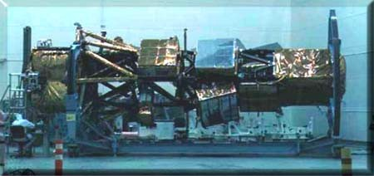
Declining Systems Engineering Expertise Contributes to a Spectacular Satellite Failure
Future Imagery Architecture - FIA - a $5 billion (award) spy satellite system was behind schedule and expected costs to complete were $13 billion over budget.
The optical satellite system of FIA was canceled in 2005 after 6 years and spending more than $4 billion.
“ … (a) factor was a decline of American expertise in systems engineering, the science and art of managing complex engineering projects to weigh risks, gauge feasibility, test components and ensure that the pieces come together smoothly.” NYT, 11/11/07
Notes:
Reference: FAILURE TO LAUNCH; In Death of Spy Satellite Program, Lofty Plans and Unrealistic Bids; New York Times, page 1; November 11, 2007; Philip Taubman
Picture: Lacrosse-5 radar spy satellite under construction; circa 2004
Pause and learn opportunity (assumptions, approximations and uncertain information). How many people were working on FIA when it was cancelled?

Slide 11
Pause and Learn Opportunity
Pre-assign the class to read the NYT article:
FAILURE TO LAUNCH; In Death of Spy Satellite Program, Lofty Plans and Unrealistic Bids; New York Times, page 1; November 11, 2007; Philip Taubman
Ask the class:
What are the top 10 reasons why the FIA Program failed?
See notes for additional discussion points.
Notes:
What are the top 10 reasons why the FIA Program failed?
1. Unrealistic tight budget; implementation under a cost cap
2. Fast, unrealistic schedule
3. Ambitious technology; pushing the state-of-the-art without significant R&D investment
4. Lack of government (NRO) oversight; contractor was asked to police itself
5. Complex design leading to infeasible manufacturing
6. Design changes based on added requirements from Washington; additional system functions required post 9/11.
7. Lack of engineering standards between the prime and the suppliers (tin example)
8. Lack of realistic cost estimates
9. Inexperienced contractor (ethics of bidding)
10. Use of COTS parts; cutbacks on testing
Other discussion points to make:
- Paradigm of faster-better-cheaper; did not work; joke- pick any 2
- Use of review panels for expert/independent opinion
- 2 independent cost estimates after the fact
- Aim for only one miracle per program

Slide 12
Definition Phase Investment is Critical to Managing Cost Overruns
(Percent)
GRO76
OMV
GALL
TDRSS
IRAS
HST
TETH
GOES I-M
MARS
EDO
CEN
LAND76
ACT
MAG
ERB77
COBE
CHA.REC.
STS
LAND78
GRO82
SEASAT
ERB88
UARS
EUVE/EP
VOY
HEAO
DE
ULYS
SMM
PIONVEN
IUE
ISEE
Notes:
Source:Understanding the Value of Systems Engineering; Eric Honour; INCOSE 2004
Pause and reflect: What is the optimum definition phase percentage?
This chart is transcribed from a manual chart created by Werner Gruhl NASA Comptroller’s Office in 1992 prior to his retirement. Individual data points are labeled with project names such as “STS” (Shuttle), Pioneer/Venture, Venus probes, etc. Each point is a major NASA project. “Definition” percent is based on phases A & B of the five-phase NASA project model. This chart shows how important it is to define the project before starting the detail work.
Note distinction from SE. This is “project definition,” not SE. Project definition includes some tasks that are not SE, such as model prototyping, program management, etc. SE also includes tasks in phases C, D, & E that are not included in this chart.
Systems engineering resources must support affordability. Past experience supports the premise that projects that invest more in systems engineering (as a percentage of total cost) have less of a chance of cost overrun.
Note: Program Overrun is calculated as (Phase A + Phase B) / (cost to complete estimate at confirmation +Phase A + Phase B)

Slide 13
Cost and Schedule Overruns Continue to be a Problem on Space Projects
Most of the NASA project data used for the ‘Werner Gruhl plot’ are more than 20 years old.
A study of 40, more recent NASA missions (including those below) showed an average cost growth of 27% and an average schedule growth of 22%.
• Discovery
– NEAR
– Lunar Prospector
– Genesis
– Messenger
– Mars Pathfinder
– Stardust
– Contour
– Deep Impact
• Mars Exploration
– MGS
– MCO/MPL
– MER
– MRO
• New Millennium
– DS-1
– EO-1
• Explorer
– FAST
– ACE
– TRACE
– SWAS
– WIRE
– FUSE
– IMAGE
– MAP
– HESSI
– GALEX
– SWIFT
– HETE-II
– THEMIS
• Great Observatory Class
– Spitzer
– Gravity Probe B
• Flagship
– EOS-Aqua
– EOS-Aura
– TRMM
• Solar Terrestrial Probe
– TIMED
– STEREO
• Other
– LANDSAT-7
– SORCE
– ICESAT
Notes:
The NASA mission start dates were between 1989 and 2004.
Using Historical NASA Cost and Schedule Growth to Set Future Program and Project Reserve Guidelines; Debra L. Emmons, Robert E. Bitten, Claude W. Freaner; IEEE Aerospace Conference, Big Sky, Montana, March 3-10, 2007.

Slide 14
Systems Engineering Process Models Begin with Reductionism
Reductionism, a fundamental technique of systems engineering, decomposes complex problems into smaller, easier to solve problems - divide and conquer is a success strategy.
Systems engineering divides complex development projects by product and phase.
Decomposing a product creates a hierarchy of progressively smaller pieces; e.g.,
  System, Segment, Element, Subsystem, Assembly, Subassembly, Part
Decomposing the development life of a new project creates a sequence of defined activities; e.g.,
  Need, Specify, Decompose, Design, Integrate, Verify, Operate, Dispose

Slide 15
A Traditional View of the Systems Engineering
Process Begins with Requirements Analysis
Measure progress and effectiveness; assess alternatives; manage configuration, interfaces, data products and program risk
Systems Analysis,
Optimization & Control
Requirements Loop
Understand the requirements and how they affect the way in which the system must function.
Requirements
Analysis
Design Loop
Functional
Allocation
Identify a feasible solution that functions in a way that meets the requirements
Synthesis/
Design
Verification Loop
Show that the synthesized design meets all requirements
Notes:
Source: From University Nanosatellite Program briefing by the Air Force Research Lab representative, Brian Engberg. Adapted from the draft Systems Engineering Mil Standard 499B; May 1994.
See also DAU Systems Engineering Fundamentals, 2001, page 6

Slide 16
The Systems Engineering ‘Vee’ Model Extends the Traditional
View with Explicit Decomposition and Integration
Mission
Requirements
& Priorities
System
Demonstration
& Validation
Develop System
Requirements &
System Architecture
Integrate System &
Verify
Performance Specs
Allocate Performance
Specs & Build
Verification Plan
Component
Integration &
Verification
Design
Components
Verify
Component
Performance
Integration &
Verification Sequence
Decomposition &
Definition Sequence
Fabricate, Assemble,
Code &
Procure Parts
Time & Project Maturity
Notes:
See for example: Forsberg, K., Mooz, H., Cotterman, H. Visualizing Project Management, 3rd edition, John Wiley and Sons, New York, NY, 2005.

Slide 17
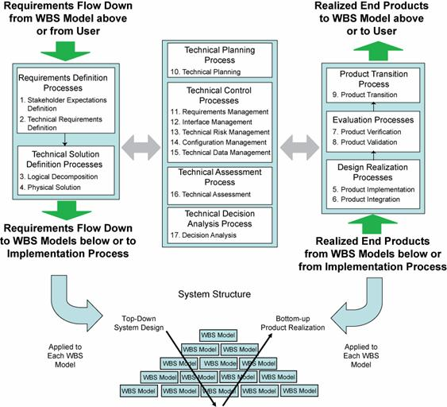
The NASA Systems Engineering Engine Adds to the Vee By Adding Optimization and Control
Optimization and Control
Processes 10 - 17

Slide 18
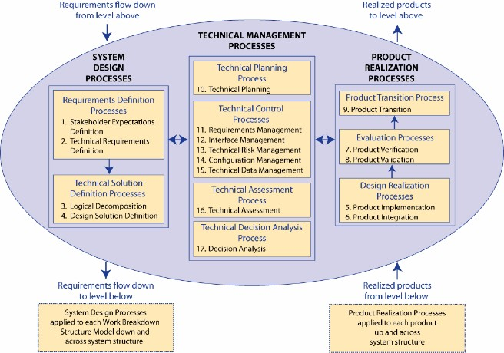
NASA Systems Engineering Engine
NASA Systems Engineering Handbook SP-6105, 2007

Slide 19
Good Systems Engineering Requires Competency in at Least 3 Domains
The NASA systems engineering engine has 17 process activities or systems engineering functions for system design, realization and management.
But good systems engineering also requires technical domain and personal attribute competency. This view is captured by the JPL system engineering competency model.
Personal Behaviors
Systems Engineering Functions
Captured by the 17 process activities
Domain Specific Technical Knowledge
Notes:
If You Want Good Systems Engineers, Sometimes You Have To Grow Your Own!; Jansma, P.A., Derro, M.E.; Jet Propulsion Lab., Pasadena
This paper appears in: Aerospace Conference, 2007 IEEE; Publication Date: 3-10 March 2007; Location: Big Sky, MT; ISSN: 1095-323X; ISBN: 1-4244-0525-4
Examples of domain specific technical knowledge areas
Flight/Spacecraft/Payload Systems Engineering
Mission Operations System (MOS) Systems Engineering
Ground Data System (GDS) Systems Engineering
Avionics Systems Engineering
Deep Space Network (DSN) Systems Engineering
Entry, Descent and Landing (EDL) Systems Engineering
Guidance, Navigation and Control Systems Engineering
Instrument Systems Engineering
Mechanical Systems Engineering
Power Systems Engineering
Project Software Systems Engineering (PSSE)
Propulsion Systems Engineering
Software Systems Engineering (SSE)
Telecommunications Systems Engineering
Thermal/Fluid Systems Engineering
Examples of Personal Behaviors
Leadership Skills
Has the ability to influence
Has the ability to work with a team
Has the ability to trust others
Communicates vision and technical steps needed to reach implementation
Mentors and coaches less experienced systems engineers
Attitudes and Attributes
Has intellectual self-confidence
Has intellectual curiosity interrelationships
Has ability to understand and manage change
Remains objective and maintains a healthy skepticism
Communication
Advances ideas and fosters open two-way discussions
Communicates through storytelling and analogies
Listens effectively and translates information
Problem Solving and Systems Thinking
Manages risk
Thinks critically and penetrates a topic in a methodical manner

Slide 20
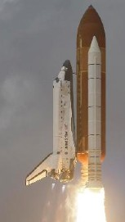
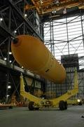
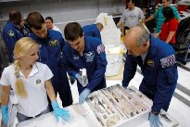

What is a System?
Simply stated, a system is an integrated composite of people, products, and processes that provide a capability to satisfy a stated need or objectives.
What are examples of a system in the aerospace industry?
Hardware
Facilities
Personnel
Processes
Notes:
From Boeing:
Elements of a System:
Equipment Hardware -- Software -- Facilities -- Personnel -- Data

Slide 21
Examples of Systems
Space Shuttle Main Engine vs. a collection of parts
Space Shuttle Orbiter with engines and avionics
Space Shuttle Orbiter with solid rocket boosters and external fuel tank
Space Transportation System (STS) with payload, launch pad, mission controllers, vehicle assembly facilities, trainers and simulators, solid rocket booster rescue ships…
“System of Systems”
  STS + International Space Station + TDRSS communication satellites +…
Notes:
Depends on ones perspective, and level of involvement.

Slide 22
Module Summary: What is Systems Engineering?
Systems engineering is a robust approach to the design, creation, and operation of systems.
Systems engineering is a ubiquitous and necessary part of the development of every space project.
The function of systems engineering is to guide the engineering of complex systems.
Most space projects struggle keeping to their cost and schedule plans. Systems engineering helps reduce these risks.
Systems engineering decomposes projects in both the product and time domain, making smaller problems that are easier to solve.
System decomposition and subsequent system integration are foundations of the Vee and the NASA systems engineering process models.

Slide 23
Backup Slides for Introduction Module
Supplemental thoughts on Systems Engineering from various sources, as specified in the notes section.

Slide 24
What is Systems Engineering?
Systems engineering is an interdisciplinary engineering management process to evolve and verify an integrated, life-cycle balanced set of system solutions that satisfy customer needs.
Accomplished by integrating 3 major activities:
Development phasing that controls the design process and provides baselines that coordinate design efforts.
A systems engineering process that provides a structure for solving design problems and tracking requirements flow through the design effort.
Life cycle integration that involves the customers in the design process and ensure that the system developed is viable throughout its life.
The function of systems engineering is to guide the engineering of complex systems.
Notes:
Source: Systems Engineering Fundamental; Defense Acquisition University; 2001
The function of systems engineering is to guide the engineering of complex systems.
Source; Systems Engineering Principles and Practice; Kossiakoff and Sweet; 2003

Slide 25
Systems Engineering -
Further Considerations
Systems engineering is a standardized, disciplined management process for development of system solutions that provides a constant approach to system development in an environment of change and uncertainty.
It also provides for simultaneous product and process development, as well as a common basis for communication.
Systems engineering ensures that the correct technical tasks get done during development through planning, tracking and coordinating.
Notes:
Source: Systems Engineering Fundamentals, Defense Acquisition University, 2001

Slide 26
Systems Engineering Process
The systems engineering process is a top-down, comprehensive, and iterative problem-solving process, applied through all stages of development, that is used to:
  Transform needs and requirements into a set of system product and process descriptions (adding value and more detail with each level of development)
  Generate information for decision makers, and
  Provide input for the next level of development.
The fundamental systems engineering activities are
  Requirements analysis
  Functional analysis/allocation
  Design synthesis
Notes:
Source: Systems Engineering Fundamentals, Defense Acquisition University, 2001
This is the traditional view of systems engineering activities (e.g., Mil Standard 499B) in that the results are validated designs.
More current views (e.g., the Vee model or the NASA model as described by NPR 7123.1 or the 2007 Systems Engineering Handbook SP-6105) add more of the system lifecycle to the systems engineering activities.
Namely, fabrication, integration, verification, validation, operation and disposal.

Slide 27
System, Systems Engineering, and Project Management
  System – The combination of elements that function together to produce the capability required to meet a need. The elements include all hardware, software, equipment, facilities, personnel, processes, and procedures needed for this purpose.
  Systems Engineering – A disciplined approach for the definition, implementation, integration and operation of a system (product or service). The emphasis is on achieving stakeholder functional, physical and operational performance requirements in the intended use environments over its planned life within cost and schedule constraints. Systems engineering includes the engineering processes and technical management processes that consider the interface relationships across all elements of the system, other systems or as a part of a larger system.
  The discipline of systems engineering uses techniques and tools appropriate for use by any engineer with responsibility for designing a system as defined above. That includes subsystems.
  Project Management – The process of planning, applying, and controlling the use of funds, personnel, and physical resources to achieve a specific result
Unless specifically noted hereafter we will use “Systems Engineering” to refer to the discipline not the organization.
Notes:
Source: NASA NPG 7120.5D

Slide 28
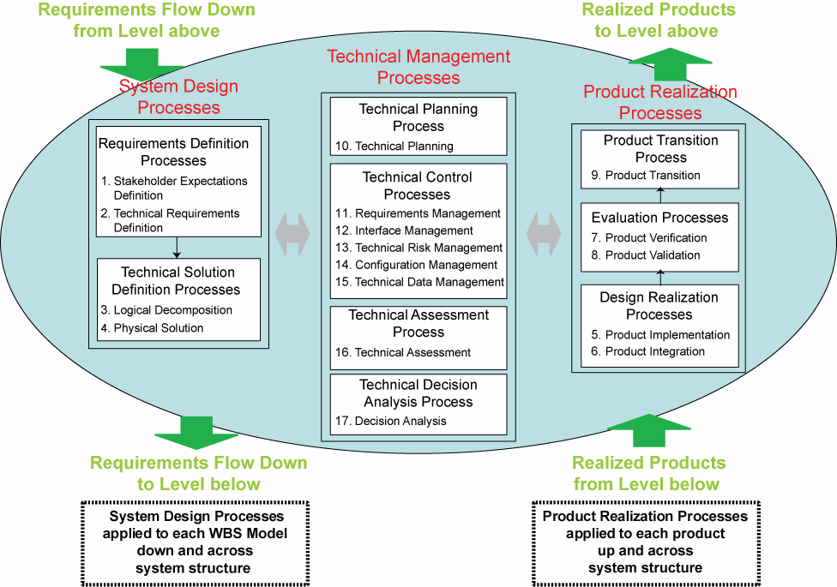
Common Technical Processes to Manage the Technical Aspect of the Project Life Cycle - NASA Model ( 7123.1A)
The Systems Engineering Engine
Notes:
Source: NASA NPR 7123, 1A Fig. 3-1

Slide 29
Systems Engineering
The systems engineering discipline shall be applied throughout the project life cycle as a comprehensive, iterative technical and management process to:
  Translate an operational need into a solution through a systematic, concurrent approach to integrated design and its related downstream processes
  Integrate the technical input of the entire development community and all technical disciplines
  Ensure the compatibility of all interfaces
  Ensure the integration, verification, and validation processes are considered throughout the life cycle starting with system concept selection
  Identify, characterize and mitigate risks
  Provide information for management decisions
Ensure and certify system integrity
Notes:
Source: the Life-cycle, Processes and Systems Engineering (LPSE) NASA course

Slide 30
With Process Comes
Systems Engineering Practices
Set up a plan for each of these EARLY!
Documentation Organization
Requirements (!!)
Materials Lists
CAD drawings
Safety documents
Interface controls
Configuration management
Design Budgets
Power
Memory/data
Communications
Mass
$$$
Other resources
Acquisition strategies
Purchase
In-house
Contribution
Other
Identify design drivers
Cost
Schedule
Performance
Interface Control
Harness & Connectors
Structural connections
Software protocols & signal processing
Execute a risk management plan
Notes:
Source: From University Nanosatellite Program briefing by the Air Force Research Lab representative, Brian Engberg.

